Slide 1

Transforming Project Approval at DonorsChoose.org

Slide 2


The Challenge: Scaling Impact
DonorsChoose.org faces a critical hurdle: efficiently vetting nearly 500,000 project proposals annually.
Scalability
Consistency
Resources
Manual processes are reaching their limits.
Ensuring fair evaluations across all proposals.
Optimizing volunteer efforts for maximum impact.

Slide 3
Our Data-Driven Approach
We leveraged machine learning to streamline project vetting, starting with in-depth Exploratory Data Analysis.
Class Imbalance
Teacher Experience
85% of projects approved, 15% not approved. A key factor for model training.
Experienced teachers' projects are significantly more likely to be approved.

Slide 4

Essay Length & Detail Matters
Our analysis shows a statistically significant link between essay length and project approval.
Approved Projects: Average 258 words
Not Approved Projects: Average 245 words
This suggests that the level of detail and effort in the proposal description plays a crucial role.

Slide 5
Categories & Resources: Approval Trends
Project Category Impact
Resource Request Patterns
Some categories consistently show higher approval rates. For example:
Specific resource requests also correlate with approval status.
Technology: Slightly higher approval
Health & Sports, Warmth, Care & Hunger : 95.65% approval
Math, Science, Music & Arts, Supplies: Notably lower approval
Music & The Arts, Warmth, Care & Hunger: 50% approval

Slide 6
Actionable Recommendations
Translate data insights into strategic enhancements for DonorsChoose.org.
Targeted Guidance
Optimized Vetting
Proposal Quality
Provide specialized support for low-approval categories and first-time teachers.
Leverage the model to focus volunteer efforts on "borderline" proposals.
Encourage detailed essays and alignment with educational needs.
Clarity & effort increase probability
Mentorship programs
Fast-track high-likelihood approvals
Enhanced resource guides
Integrate technology where appropriate
Improve overall efficiency

Slide 7
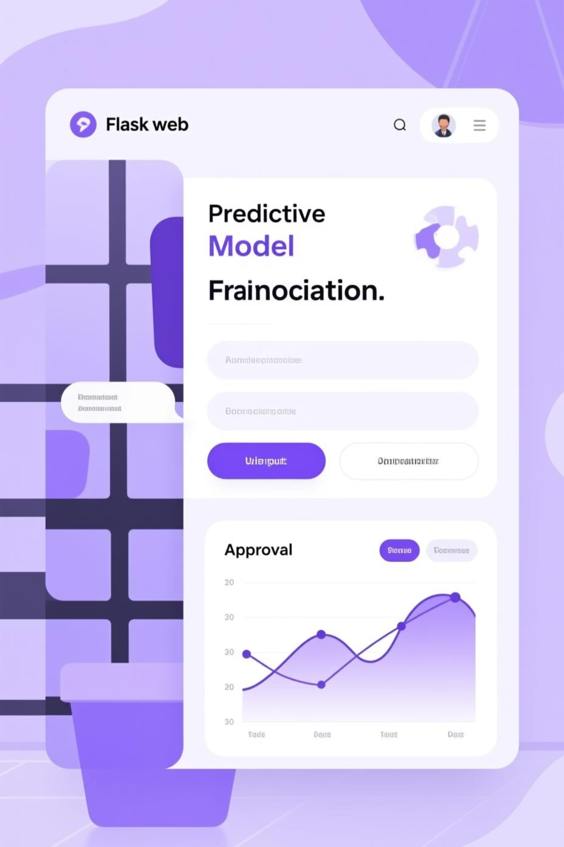
Bringing Predictions to Life
We developed a Flask web application with an interactive user interface to demonstrate the model's capabilities.

Slide 8
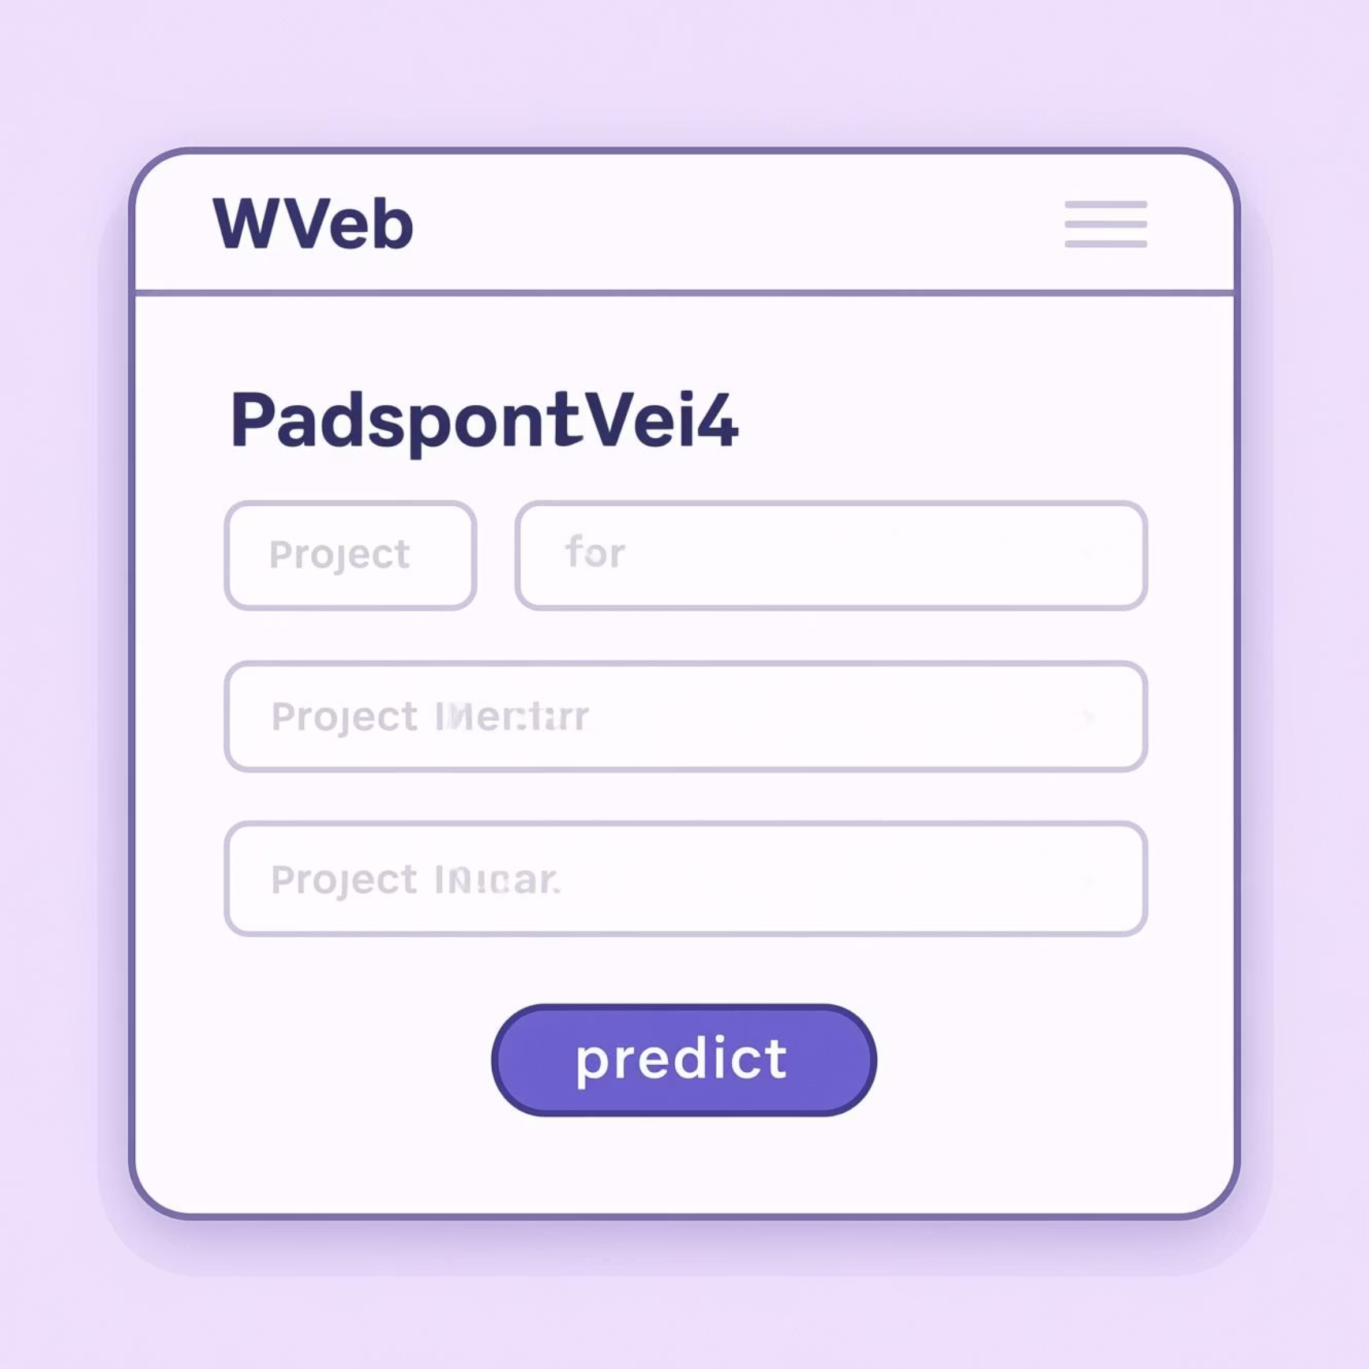
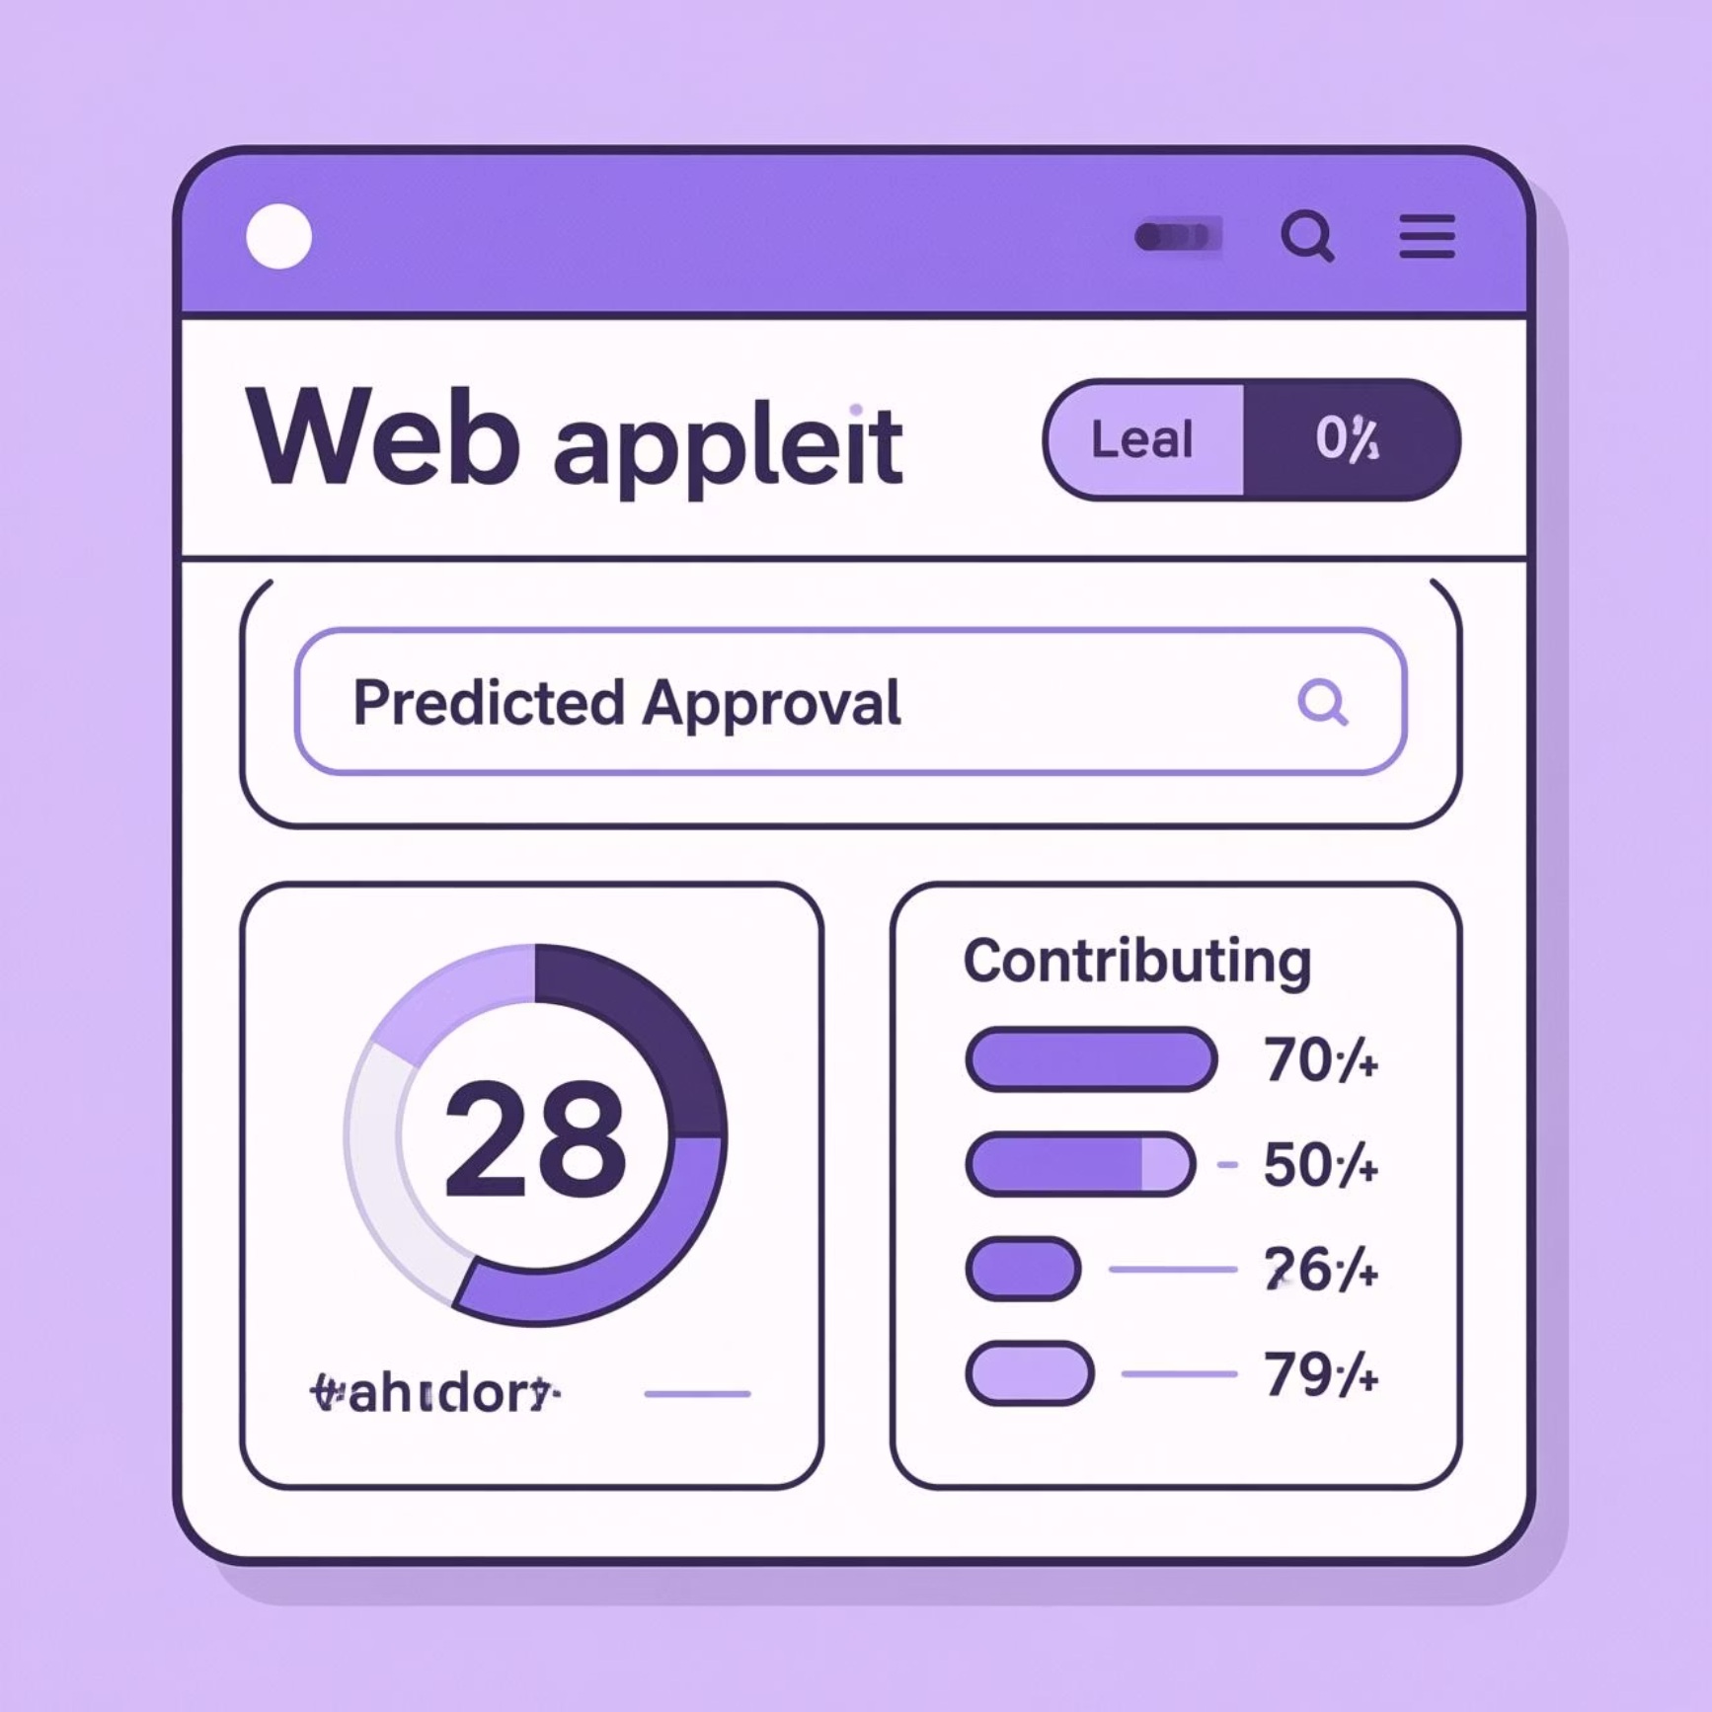
Deployed Project Demonstration
See our predictive model in action.
Intuitive Input
Instant Predictions
Easily enter project details for instant analysis.
Receive immediate approval probability and insights.

Slide 9
Key Takeaways
1
Data-Driven Efficiency
2
Fair & Consistent Vetting
3
Empowering Teachers
Machine learning provides a concrete solution to operational challenges.
Ensuring every project receives optimal consideration.
Faster access to resources means more successful classroom projects.

Slide 10

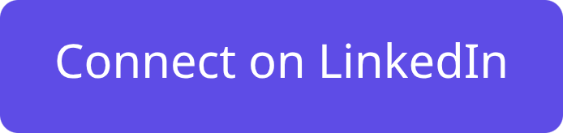
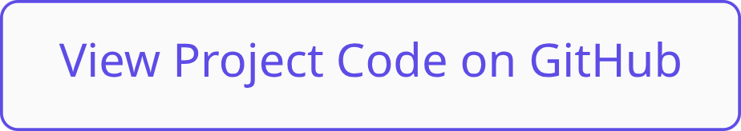
Thank You!
This project aims to support DonorsChoose.org in its mission to fund classroom projects.
LinkedIn :
https://www.linkedin.com/in/rambawankule/
GitHub Repository : https://github.com/rambawankule/donors_choose_approval_prediction

